Slide 1
Linear Algebra
Lecture 22

Slide 2
Vector Spaces

Slide 3
Linearly
Independent
Sets; Bases

Slide 4
Definition
Let V be an arbitrary nonempty set of objects on which two operations are defined, addition and multiplication by scalars.

Slide 5
If the following axioms are satisfied by all objects u, v, w in V and all scalars l and m, then we call V a vector space.

Slide 6
Axioms of Vector Space
For any set of vectors u, v, w in V and scalars l, m, n:
1. u + v is in V
2. u + v = v + u

Slide 7
3. u + (v + w) = (u + v) + w
4. There exist a zero vector 0 such that
0 + u = u + 0 = u
5. There exist a vector –u in V such that
-u + u = 0 = u + (-u)

Slide 8
6. (l u) is in V
7. l (u + v)= l u + l v
8. m (n u) = (m n) u = n (m u)
9. (l +m) u= I u+ m u
10. 1u = u where 1 is the multiplicative identity

Slide 9
Definition
A subset W of a vector space V is called a subspace of V if W itself is a vector space under the addition and scalar multiplication defined on V.

Slide 10
Theorem
If W is a set of one or more vectors from a vector space V, then W is subspace of V if and only if the following conditions hold:

Slide 11
continued
(a) If u and v are vectors in W, then u + v is in W
(b) If k is any scalar and u is any vector in W, then k u is in W.

Slide 12
Definition
The null space of an m x n matrix A (Nul A) is the set of all solutions of the hom equation Ax = 0
Nul A = {x: x is in R^{n} and Ax = 0}

Slide 13
Definition
The column space of an m x n matrix A (Col A) is the set of all linear combinations of the columns of A.

Slide 14
Definition
The column space of an m x n matrix A (Col A) is the set of all linear combinations of the columns of A.

Slide 15
continued
If A = [a₁ … a_{n}],
then
Col A = Span {a₁ ,… , a_{n} }

Slide 16
Linearly
Independent
Sets; Bases

Slide 17

Definition
An indexed set of vectors {v₁,…, v_{p}} in V is said to be linearly independent if the vector equation
has only the trivial solution,
c₁=0, c₂=0,…,c_{p}=0

Slide 18
Definition
The set {v₁,…,v_{p}} is said to be linearly dependent if (1) has a nontrivial solution, that is, if there are some weights, c₁,…,c_{p}, not all zero, such that (1) holds. In such a case, (1) is called a linear dependence relation among v₁, … , v_{p}.

Slide 19
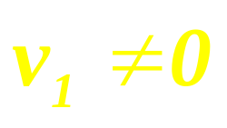

Theorem
An indexed set { v₁, … , v_{p} } of two or more vectors, with , is linearly dependent if and only if some v_{j} (with ) is a linear combination of the preceding vectors, v₁, … , v_{j-1}.

Slide 20
Example 1
Let p₁ (t) = 1, p ₂(t) = t and p ₃ (t) = 4 – t. Then
{p ₁, p ₂, p ₃} is linearly dependent in P because
p₃ = 4p₁ – p₂.

Slide 21
Example 2
The set {Sint,Cost} is linearly independent in C[0,1] because Sint and Cost are not multiples of one another as vectors in C [0,1]. …

Slide 22
continued
However, {Sint Cost,Sin2t}
is linearly dependent because of the identity:
Sin 2t = 2 Sin t Cos t,
for all t.

Slide 23
Definition
Let H be a subspace of a vector space V. An indexed set of vectors
B = {b₁,…, b_{p}} in V is a basis for H if
…

Slide 24
continued
B is a linearly independent set, and the subspace spanned by B coincides with H; that is,
H = Span {b₁,...,b_{p} }.

Slide 25
Example 3
Let A be an invertible n x n matrix – say, A = [a₁ … a_{n}]. Then the columns of A form a basis for R^{n} because they are linearly independent and they span R^{n}, by the Invertible Matrix Theorem.

Slide 26
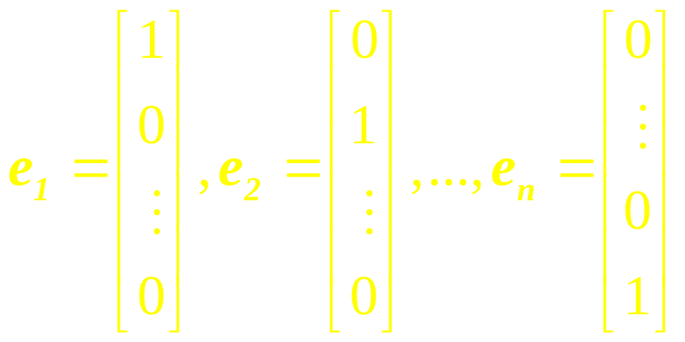
Example 4
Let e₁,…, e_{n} be the columns of the identity matrix, I_{n}. That is,
The set {e₁, …, e_{n}} is called the standard basis for R^{n}.

Slide 27
Standard Bases for R³
x₃
e₃
e₂
x₂
e₁
x₁

Slide 28
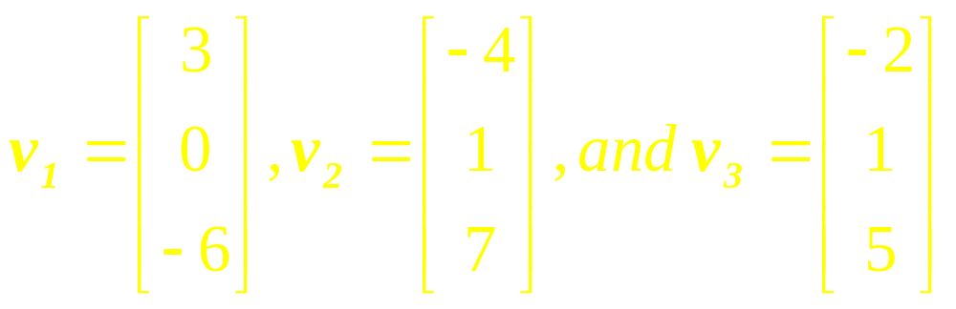
Example 5
Determine if {v₁, v₂, v₃} is a basis for R³.

Slide 29
Example 6
Let S = {1, t, t², …, t^{n}}. Verify that S is a basis for P_{n}. This basis is called the standard bases for P_{n}.

Slide 30
Standard Bases for P₂
y
y = t²
y = 1
t
y = t

Slide 31
Example 7
Check whether the set of vectors
{(2, -3, 1), (4, 1, 1), (0, -7, 1)} is a basis for R³ ?

Slide 32
Example 8
Check whether the set of vectors
{-4 + 1 t + 3 t², 6 + 5 t + 2 t², 8 + 4 t + 1 t²}
is a basis for P₂?

Slide 33
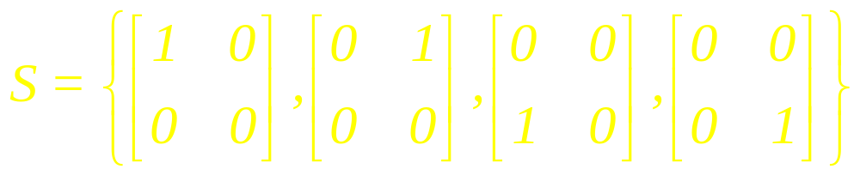
Example 9
Show that the set
is a basis for the vector space V of all 2 x 2 matrices.

Slide 34
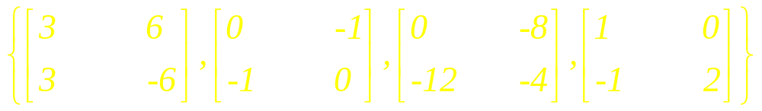
Example 10
Show that the set
is a basis for the vector space V of all 2 x 2 matrices.

Slide 35
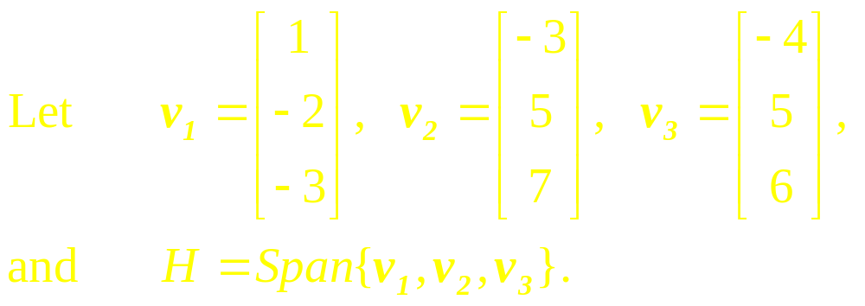
Example 11
Note that v₃ = 5v₁ + 3v₂ and show that Span {v₁, v₂, v₃} = Span {v₁, v₂}. Then find a basis for the subspace H.

Slide 36
Spanning Set
Theorem

Slide 37

Let S = {v₁, … , v_{p}} be a set in V and let H = Span {v₁, …, v_{p}}.
(a) If one of the vectors in S, say v_{k}, is a linear combination of the remaining vectors in S, then the set formed from S by removing v_{k} still spans H.
(b) If H {0}, some subset of S is a basis for H.

Slide 38
Procedure
The procedure for finding a subset of S that is a basis for W = span S is as follows:
1. Write the Equation,
c₁v₁ + c₂v₂ + …+ c_{n} v_{n} = 0

Slide 39
continued
2. Construct the augmented matrix associated with the
homogeneous system of
equation and transform it to reduced row echelon form.

Slide 40
continued
3. The vectors corresponding to the columns containing the leading 1’s form a basis
for W = span S.

Slide 41
Thus if S = {v₁, v₂,…, v₆} and the leading 1’s occur in columns 1, 3, and 4,
then { v₁ , v₃ , v₄}
is a basis for span S.

Slide 42
Example 12
Let S = {v₁, v₂, v₃, v₄, v₅} be a set of vectors in R⁴, where
v₁ = (1,2,-2,1), v₂ = (-3,0,-4,3), v₃ = (2,1,1,-1), v₄ = (-3,3,-9,6), and v₅ = (9,3,7,-6).
Find basis for W = span S.

Slide 43
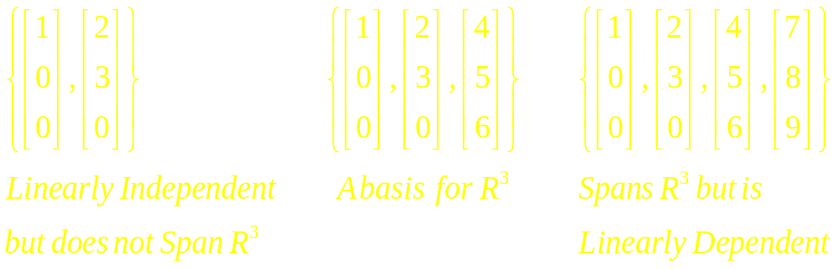
Example 13

Slide 44
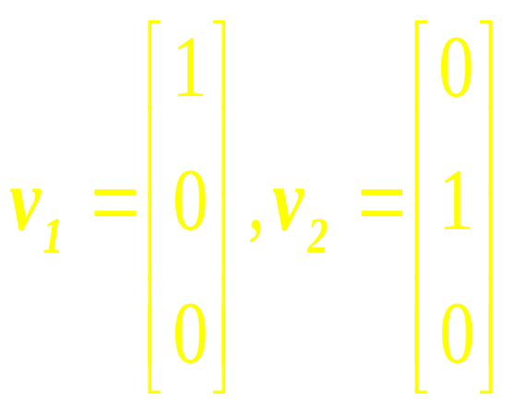
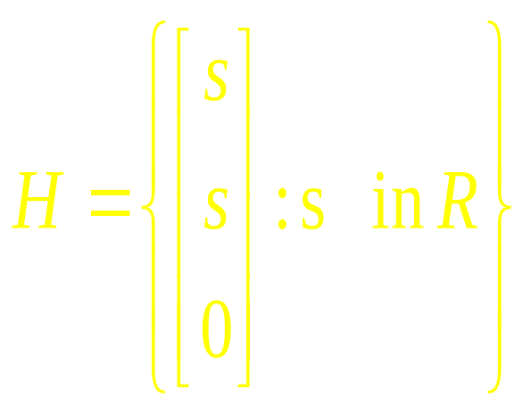
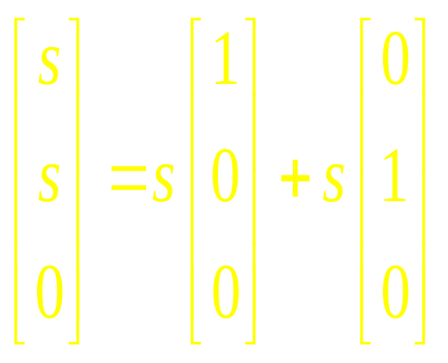
Example 14
Is {v₁, v₂} a basis for H?

Slide 45
Solution
Neither v₁ nor v₂ is in H, so {v₁, v₂} cannot be a basis for H. In fact, {v₁, v₂} is a basis for the plane of all vectors of the form (c₁, c₂, 0), but H is only a line.

Slide 46
Linear Algebra
Lecture 22

